Slide 1
DESIGN OF SINGLY REINFORCED
BEAM BY WSM BY A. Ansari Assist Professor ACET,Nagpur

Slide 2
The aim of design is:
To decide the size (dimensions) of the member and the amount of reinforcement required.
To check whether the adopted section will perform safely and satisfactorily during the life time of the structure.

Slide 3
C1 BATCH DATA
A 1 to 6 M20 Fe 415 LL = 4 kN/m2 Effective L = 4.0 m
B 7 to 12 M25 Fe 415 LL = 2.5 kN/m2 Effective L = 3.5 m
C 13 to 18 M20 Fe 415 LL = 2 kN/m2 Effective L = 4 m
D 19 to 24 M20 Fe 500 LL = 5 kN/m2 Effective L = 4.5 m
E 25 to 30 M20 Fe 415 LL = 6 kN/m2 Effective L = 5 m
F 31 to 36 M25 Fe 415 MR = 4 kN/m2 Effective L =4.3 m

Slide 4
C2 BATCH DATA
A 38 to 58 M20 Fe 415 LL = 2 kN/m2 Effective L =4.3 m
B 40 to 65 M25 Fe 415 LL = 2.3 kN/m2 Effective L = 5 m
C 37 to 46 M20 Fe 415 LL = 2.5 kN/m2 Effective L = 4.5 m
D 48 to 55 M20 Fe 500 LL = 5.6 kN/m2 Effective L = 4 m
E 60 to 71 M20 Fe 415 LL = 6.2 kN/m2 Effective L = 3.5 m

Slide 5
Procedure for Design of Singly Reinforced Beam by Working Stress Method
Given :
Span of the beam (l)
Loads on the beam
Materials-Grade of Concrete and type of steel.
1. Calculate design constants for the given materials (k, j and R)
k = m σ_{cbc} / m σ_{cbc} + σ_{st} where k is coefficient of depth of Neutral Axis

Slide 6
j = 1- k/3
where j is coefficient of lever arm.
R= 1/2 σ_{cbc} kj
where R is the resisting moment factor.
Assume dimension of beam: d = Span/10 to Span/8
Effective cover = 40mm to 50mm b = D/2 to 2/3D
Calculate the effective span (l) of the beam.
Calculate the self weight (dead load) of the beam.
Self weight = D x b x 25000 N/m

Slide 7
Calculate the total Load & maximum bending moment for the beam.
Total load (w) = live load + dead load
Maximum bending moment, M = wl² / 8 at the centre of beam for simply supported beam.
M = wl² / 2 at the support
of beam for cantilever beam.
Find the minimum effective depth
M = M_{r}
= Rbd² d_{reqd.} = √ M / R.b

Slide 8
7. Compare d_{reqd.} With assumed depth value.
If it is less than the assumed d, then assumption is correct.
If d_{reqd.} is more than assumed d, then revise the depth value and repeat steps 4, 5 & 6.
8. Calculate the area of steel required (A_{st}).
A_{st} = M / σ_{st} jd
Selecting the suitable diameter of bar calculate the number of bars required
Area of one bar = π/4 x φ² = Aφ No. of bars required = A_{st} /Aφ

Slide 9
9. Calculate minimum area of steel (A_{S}) required by the relation:
A_{S} = 0.85 bd / f_{y}
Calculate maximum area of steel by the area relation:
Maximum area of steel = 0.04bD
Check that the actual A_{St} provided is more than minimum and less than maximum requirements.

Slide 10
Check for shear and design shear reinforcement.
Check for development length.
Check for depth of beam from deflection.
Write summary of design and draw a neat sketch.

Slide 11
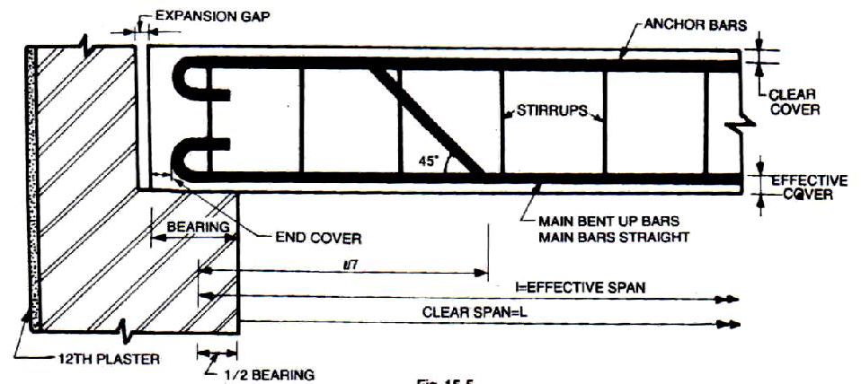
TYPICAL DEATILING OF BEAM AS PER SP-43

Slide 12
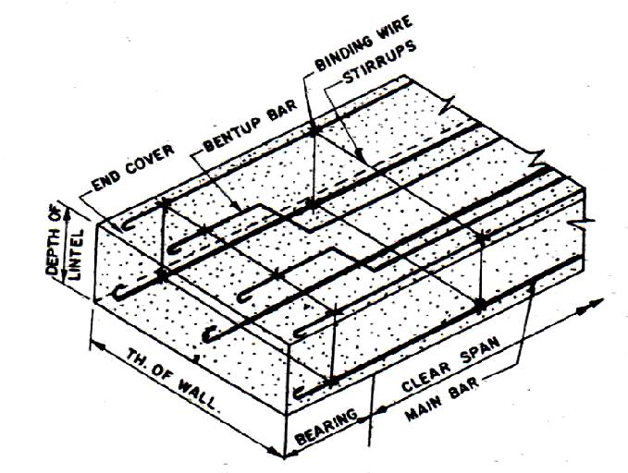

Slide 13
DESIGN THE SINGLY REINFORCED BEAM SECTION BY WSM FOR THE FOLLOWING DETAILS
M20 GRADE OF CONCERET
(2) Fe 415 GRADE OF STEEL
(3) LL = 4 kN/Sq-m
(4) Effective L =4.0 m
STEP 1 GIVEN DATA :- FOR M20 σ_{cbc =} 7.0 Mpa ,
Fe 415 σ_{st} = 230 Mpa
1. Calculate design constants for the given materials (k, j and R)
k = m σ_{cbc} / m σ_{cbc} + σ_{st =0.29}
j = 1- k/3 = 0.90

Slide 14
R= 1/2 σ_{cbc} kj = 0.5x7x0.29x0.90=0.91
where R is the resisting moment factor.
Assume dimension of beam: d = Span/10 4000/10=400mm,lets provide d=450mm (In order to safe in deflection)
Let the Effective cover 25mm therefore D=425 mm, let b=230 mm
Calculate the effective span (l) of the beam =4m
Calculate the self weight (dead load) of the beam.
Self weight = bDγc = 0.23x0.425x25
= 2.44kN/ Sq-m

Slide 15
Calculate the total Load & maximum bending moment for the beam.
Total load (w) = live load + dead load =(4+2.44)=6.44kN
Maximum bending moment, M = wl² / 8
= 6.44 x 4 ² /8 = 12.88kN-m
Maximum Shear force = V=wl /2 = 6.44x4/2=12.88kN
Find the minimum effective depth
M = M_{r}
= Rbd² d_{reqd.} = √ M / R.b
= √ 12.88 x 10⁶ / 0.91x230
= 248.07 < 450 provided hence safe

Slide 16
7. Calculate the area of steel required (A_{st}).
A_{st} = M / σ_{st} jd
= 12.88 x 10⁶ /230x0.91x450
= 136.75 mm²
Selecting the suitable diameter of bar calculate the number of bars required
Area of one bar = π/4 x 10² = 78.54 mm² No. of bars required = A_{st} /Aφ
= 136.75 / 78.54
= 1.74
= 2 Nos of 10 mm φ

Slide 17
9. Calculate minimum area of steel (A_{S}) required by the relation:
A_{S} = 0.85 bd / f_{y}
₌ 211.99 mm²
Calculate maximum area of steel by the area relation:
Maximum area of steel = 0.04bD =4140 mm²
Check that the actual A_{St} provided is more than minimum and less than maximum requirements.

Slide 18
Check for shear and design shear reinforcement.
From page 83 cl. B-5.1 IS 456-2000
= 12.88 x 10³ / 230 x 450 =0.12 Mpa
100 Asp / bd =0.15 Mpa
Hence no shear design required
Check for spacing as per cl 26.5.1.6 pg 48 IS 456-2000
Sv = 394.53mm or 0.75d=337.5mm or 300 mm hence provide 300 mm

Slide 19
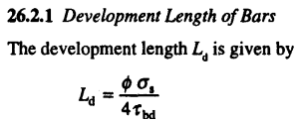
11 Check for Development length as per pg no 42 cl 26.2 and 26.2.3.3 pg 44 IS 456-2000
Ld < M1/V + Lo
= 10 x230 / (4 x 1.9)
= 302.63 mm

Slide 20
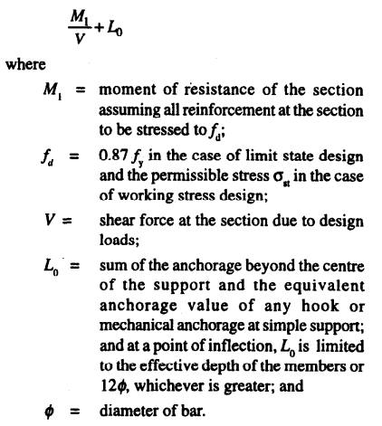
= 230/ 12.88 x 10000 + 450 = 450.02 mm
Hence safe in development length Ld

Slide 21
12 Check for deflection
l/d < B.V x MF1 xMF2xMF3

Slide 22
THE END

